Slide 1
Freedom project
From Pharell William’s song Freedom to LCE students’ own perception of what freedom simply means to them.
We’ve worked on the song lyrics, the video, freedom acrostics, visual symbols or references and the expression of their ideas.

Slide 2
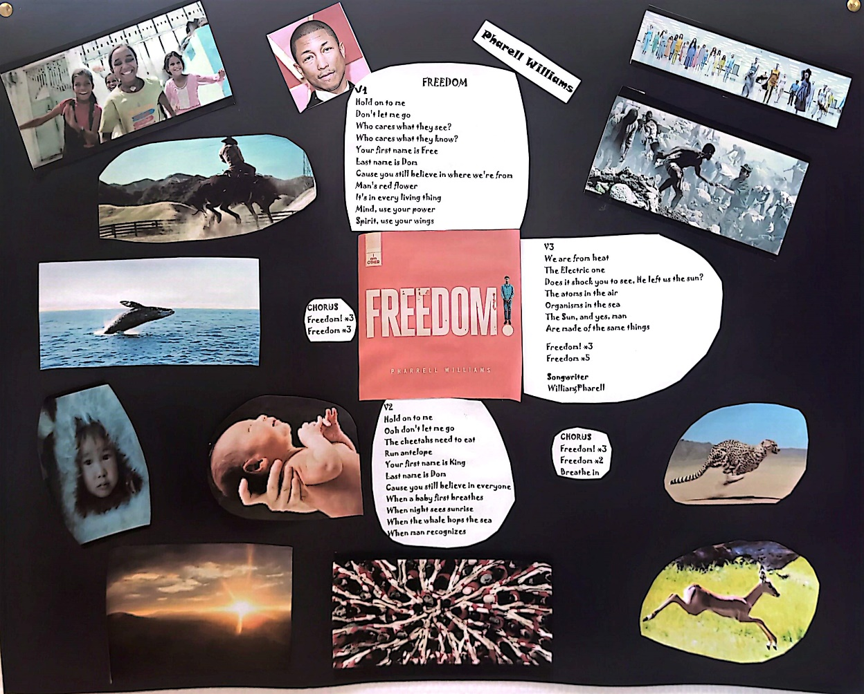
Click on the link below to access the video.
https://www.youtube.com/watch?v=LlY90lG_Fuw

Slide 3
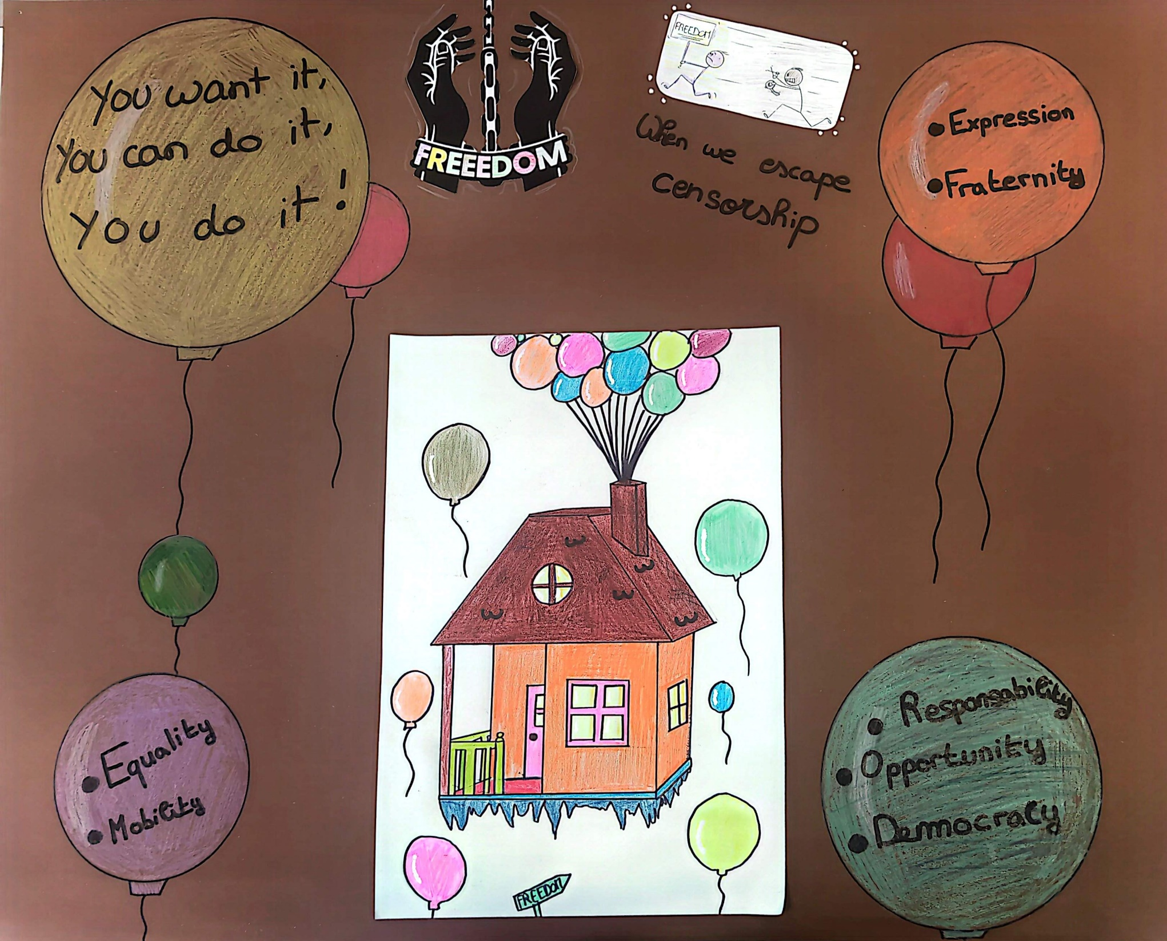

Slide 4
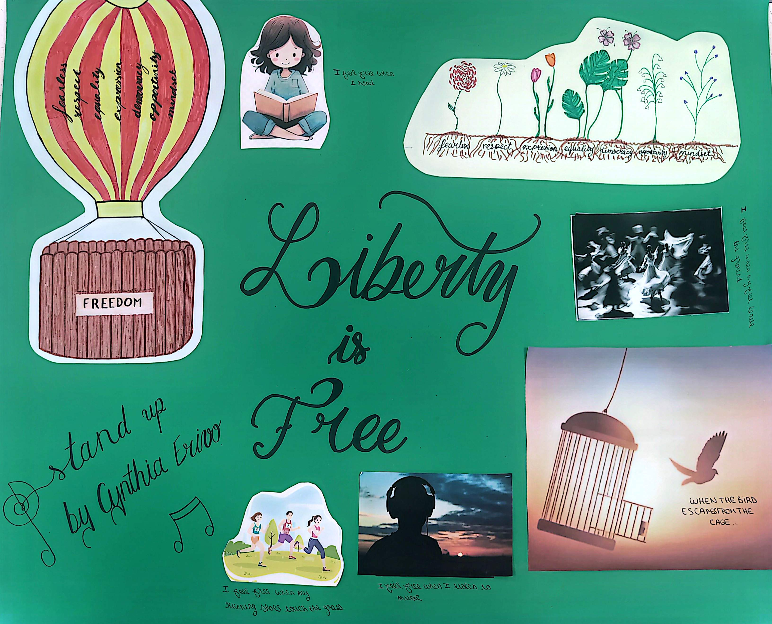

Slide 5
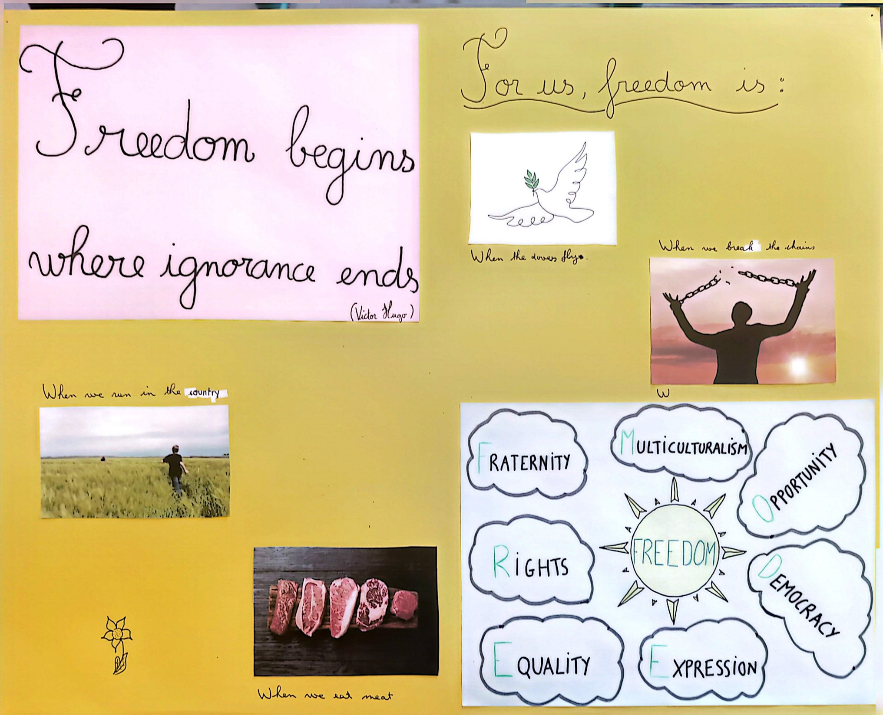

Slide 6
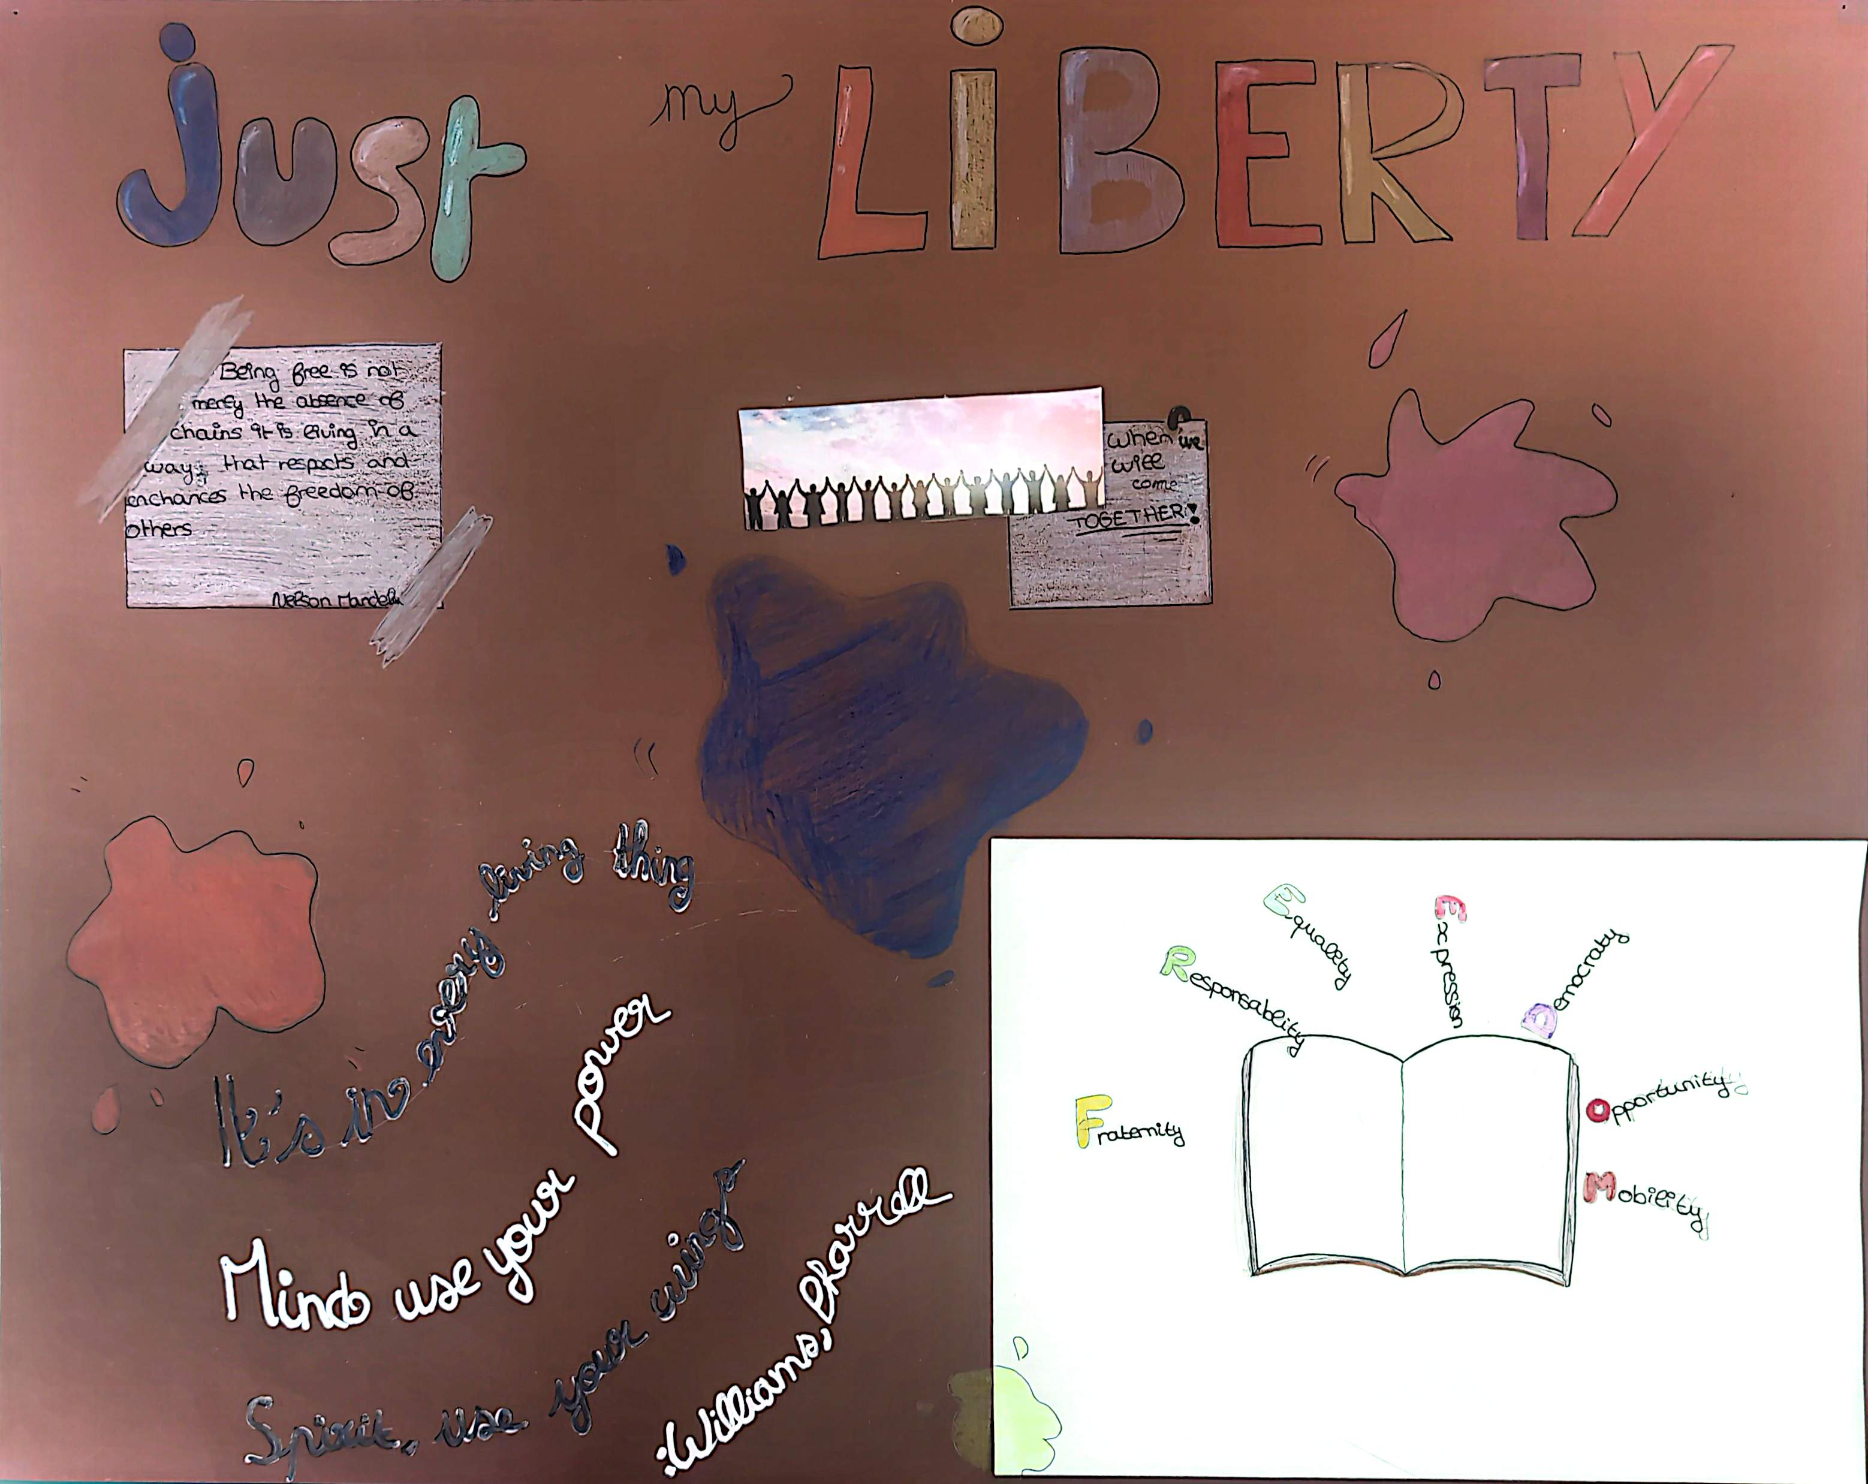

Slide 7
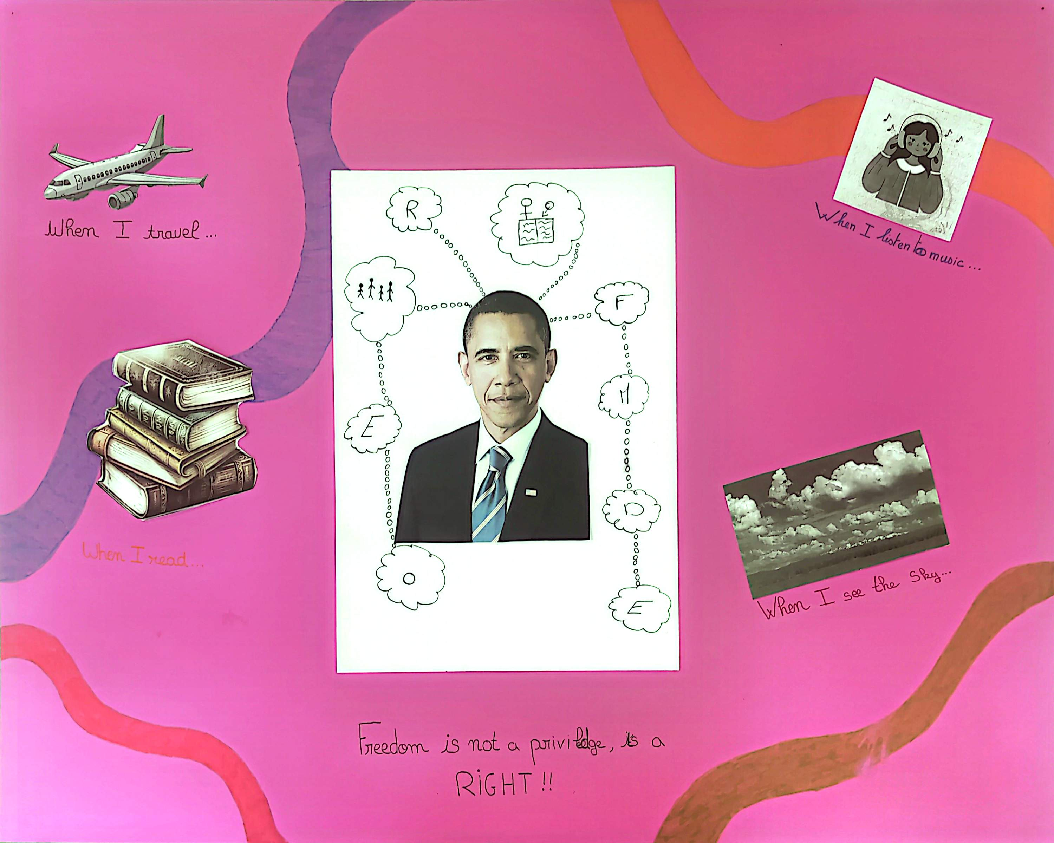

Slide 8
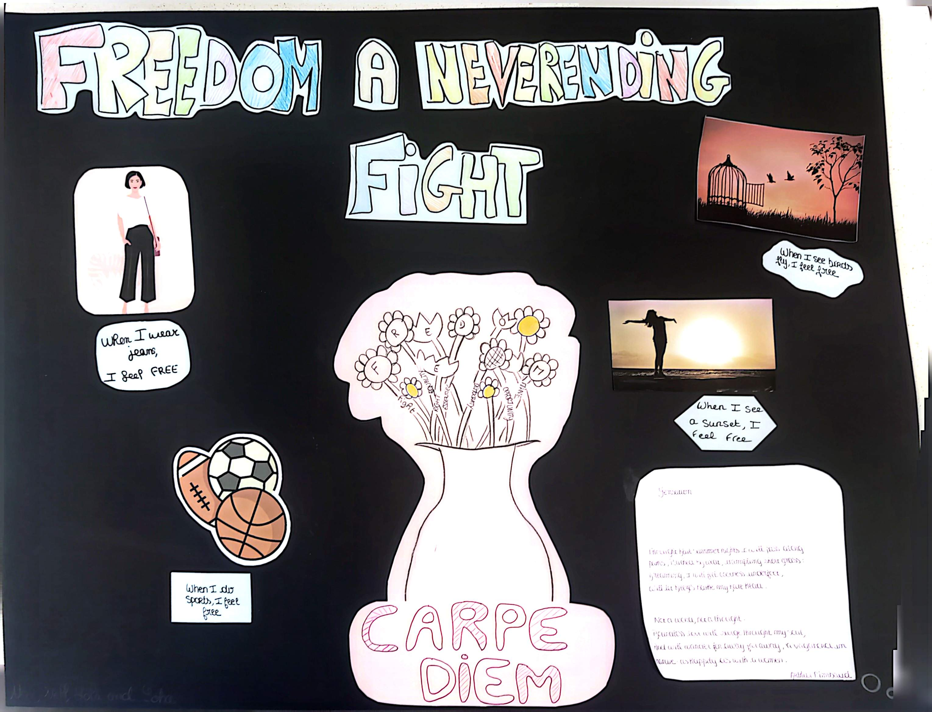

Slide 9
